Slide 1
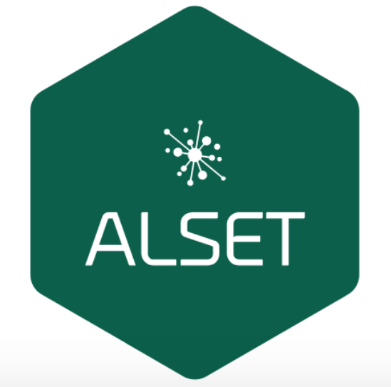
Smart Bin & A.I Waste Sorting System

Slide 2
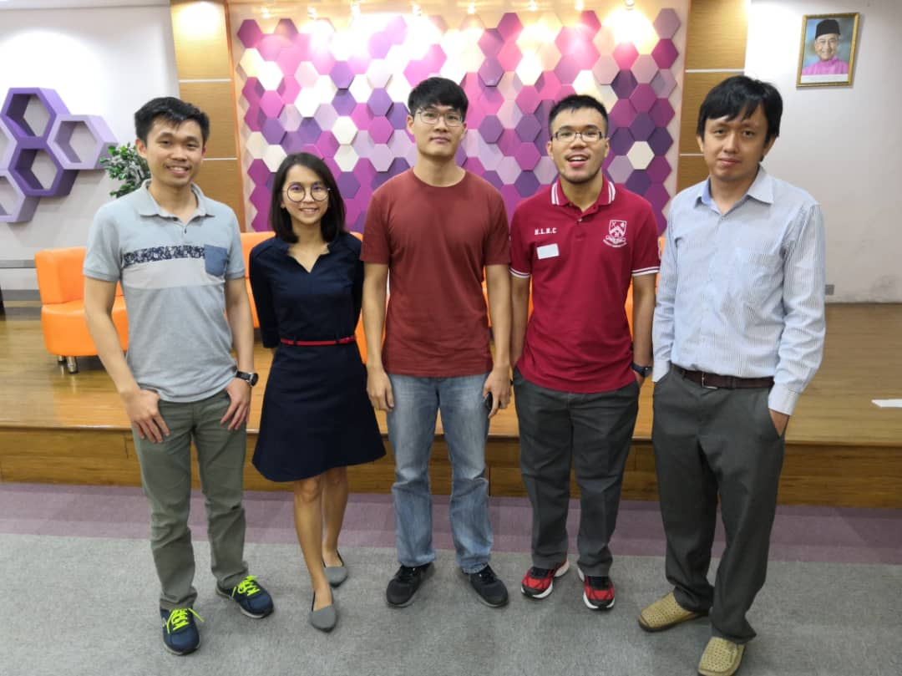
Team

Slide 3
Problem Statement
Government target recycling rate = 30% in 2020 including composting
BUT
Our recycling rate only~17.5% in 2016
YET
60-80% of waste composition discovered in our landfill are recyclables.
Meanwhile, Germany’s recycling rate is 62% in 2010
(Y. C. Moh & Abd Manaf, 2014).
Solution:
Waste Sorting System powered by AI

Slide 4
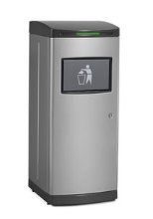
Smart Bin features
Solar panels to generate power for sustainable operations
QR reader for citizens to scan from their app and link contributions to their profile
Optimize collection routes with the knowledge of the bin’s fill levels
IoT connectivity to record citizen’s deposit by weight and type, integrating into CRM systems for rewards issuance
Smart lock based on NFC device to prevent theft
Notes:
>>waste collection crews had to check each and every trash bin without having the knowledge of their fill levels. Without the knowledge of what bins were full and empty, the task of collecting waste was unnecessarily long and tedious. With the emergence of smart bins, the fill levels will be communicated real time and the best times to collect waste and optimize collection routes will be determined from the analysis of the data provided

Slide 5
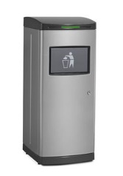
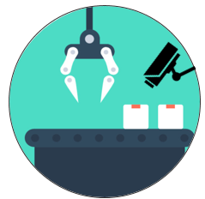
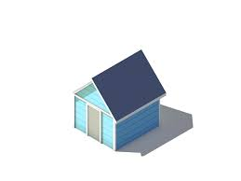


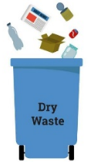

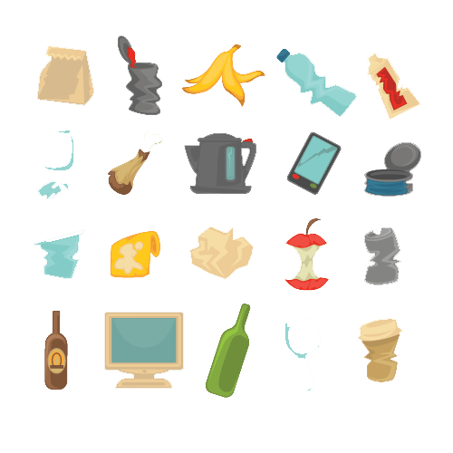
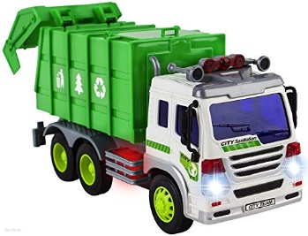



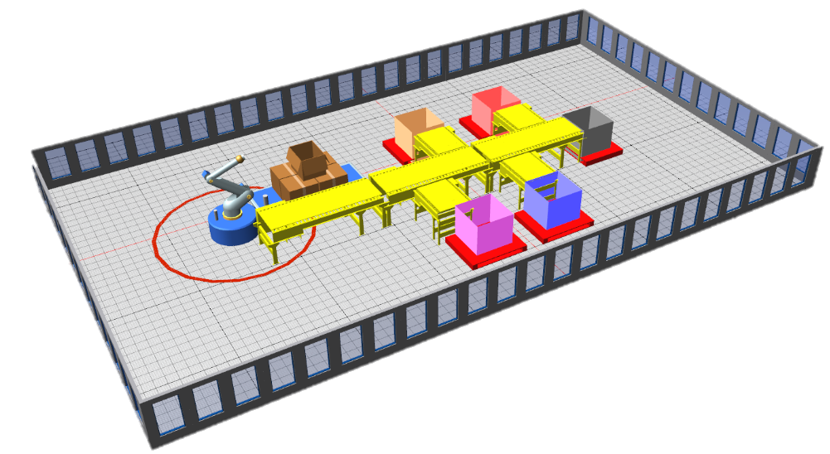



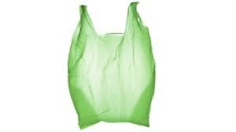
Product Background
AI SMART BIN
AI WASTE SORTING CENTRE
Implementation
1) User download App(optional) to enjoy more benefits & information when recycling
2) User required to separate Dry Waste from Food Waste
3) Logistic Partner collect dry waste & send to local sorting centre , food waste to compost centre, all built near existing landfill
4) Dry waste sorted with Image Recognition Technology
5) Higher recycling rate, generate more social, economic value with waste data

Slide 6



Impact
Commercial:
Waste Data to assist businesses in demand analysis & manage reverse logistic
R&D on potential new recycling process/ material based on actual waste data
Legal :
Building Waste Database to assist government in regulation & enforcement
Environmental :
Reduce Solid Waste to Landfilling or Incinerating

Slide 7
Let’s have some demo ☺
https://youtu.be/RBGhjd9qM_o

Slide 8
Business Model: Turning Trash into Cash
MSW Components | Weight / Ton MSW | Primary Products | Percentage Recoverable | Value of Product | Value / Ton Feedstock | Secondary Products
Organics | 440.5 | Biogas | 440.5 * 0.5 = 220.25 | RM 1.75 / m3 | RM 26.98 | Compost / Animal Feed
Plastic | 130.2 | Recycle | 130.2 * 0.5 = 65.10 | RM 0.50 / kg | RM 32.55 | Green Diesel
Paper | 80.5 |  | 80.5 * 0.5 = 40.25 | RM 0.25 / kg | RM 10.07 | Recycled paper pulp
Metal / Aluminium | 20.7 |  | 20.7 * 0.5 = 10.35 | RM 2.5 / kg | RM 25.88 | Metal /Aluminium ingots
Diapers | 120.1 | Refuse Derived Fuel | 231.6 * 0.25 = 57.9 | Rm 0.38 / kg | RM 22.00 | Energy
Textile | 30.1
Rubber | 20.2
Wood | 10.4
Garden | 50.8
Total | 1000 | 40.60% Diverted |  |  | RM117.48
Source: PEMANDU Solid Waste Management Lab 2015 report
Recovered material from MSW is worth RM 117.48 per tonne.
In year 2020, 49,670 tonne/ day of waste is expected to be generated by Malaysians.
Potential income generated from waste is RM 5.8 mil per day, RM 2.1 bil per annum!

Slide 9
Business Model: Cost and benefits
Estimated Smart Bin Cost: ~RM5,000*
Recycled waste revenue**:
Assume 100KG capacity per bin, target 10 loads a month, same composition of recyclables as table:
RM 117
LED advertising revenue ***:
RM1,000 per month
Rewards budget: RM2 per 10kg,
RM200 per month
Payback period = RM5,000 / (RM117 + RM1,000 – RM200)
~5.5 months payback

Slide 10
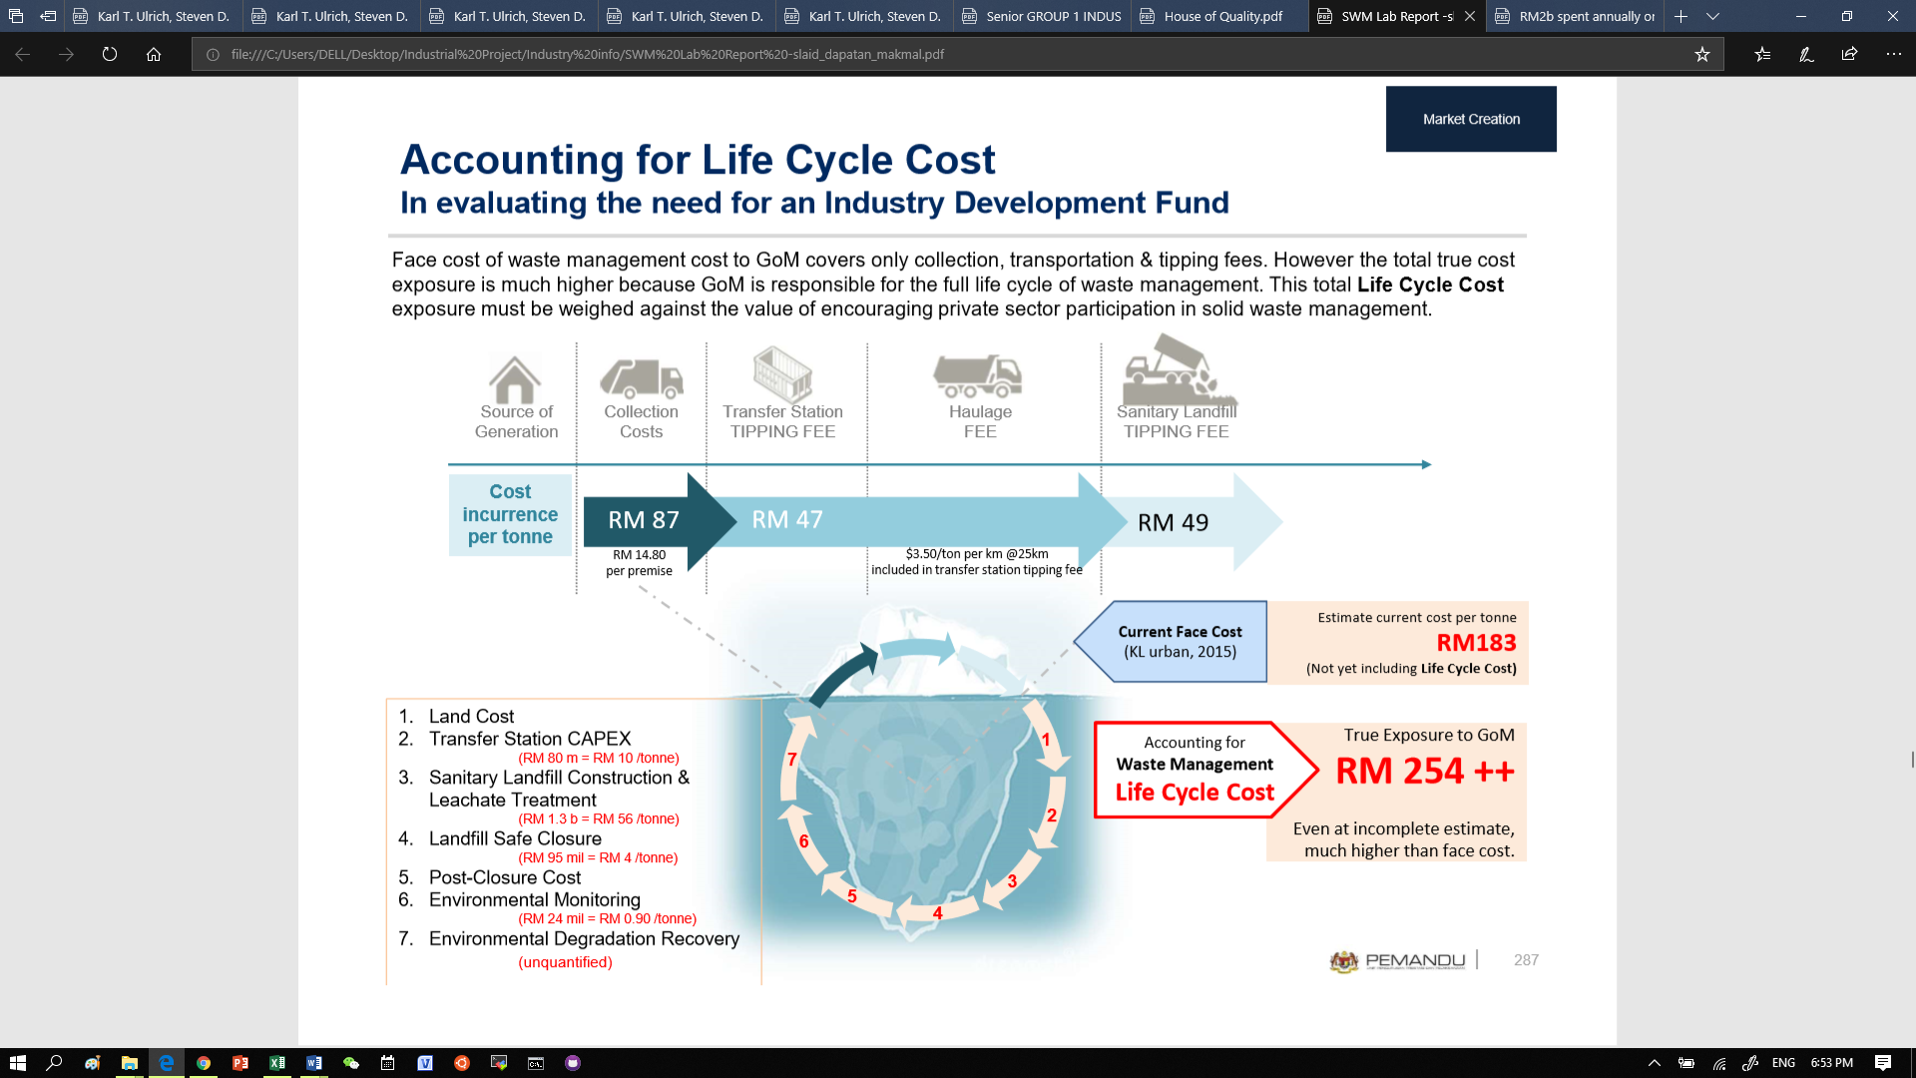
Business Model: Cost Saving
Source: PEMANDU Solid Waste Management Lab 2015 report
Potential cost savings from reduced Landfill is RM 6.3 mil per day, RM 2.3 bil per annum!

Slide 11
Thank You!
R
EDUCE EUSE ECYCLE ECREATE

